Slide 1
Photovoltaic-Diagnosis

Slide 2
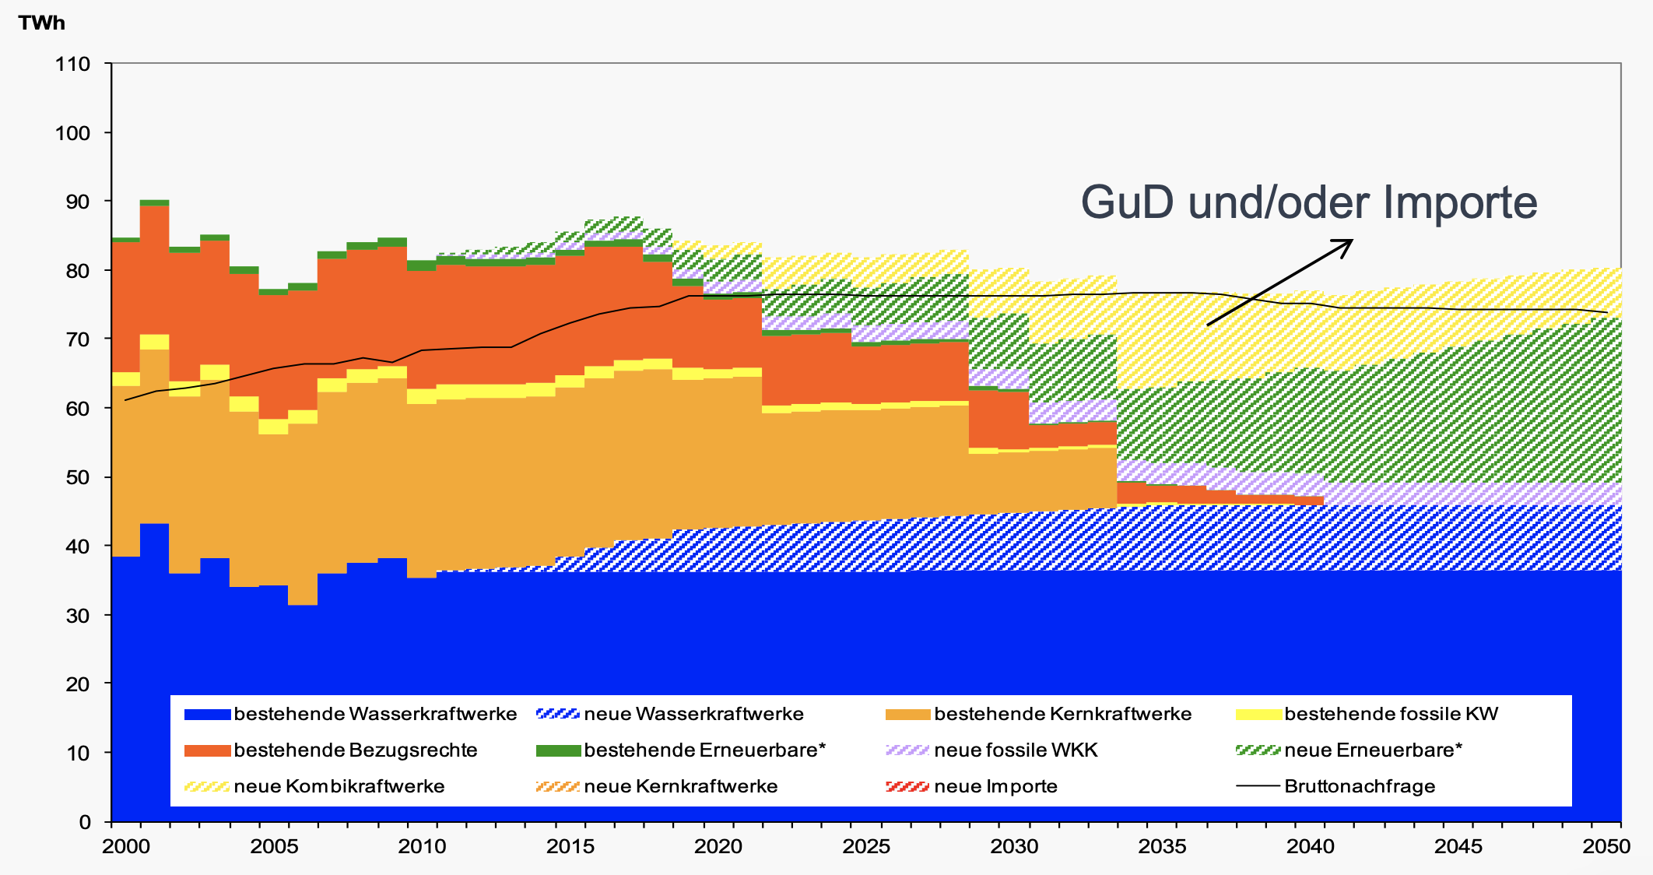
Motivation
PV in Energy Strategy 2050
ca. 10 TWh solar energy
ca. 11 GWp installed PV power
ca. 15% of total electricity demand
80% of the installed capacity @ 10 kWp = 800’000 PV installations on rooftops allover CH

Slide 3
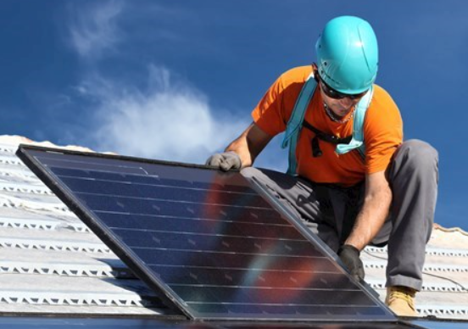
Motivation
Small PV installations are not monitored
Dirt, damange, dust and other malfunctions can deteriorate production
What if 10% of the installations do not function properly?
CH: 10 TWh * 10% * 50 CHF/MWh = 50 MCHF/year in electricity never produced
Household @ 10 kWp: 1’000 CHF/year * 800’000 install. * 10% * 50% = 40MCHF/year household income is lost
We can help monitoring this problem with data → compare actual with expected production
Simple WebApp, with which the owner of the PV-installation can check if his installation produced as much as expected

Slide 4
DataSet & Implementation
Data, general support and documentation (Martin, Tobias, Andreas, Angelos)
API sonnendach.ch (BFE): expected PV production for each rooftop in Switzerland
PV production per month from two real installations
Backend in AWS Lambda → serverless cloud application, scalable, can support different languages and frameworks (Bogdan)
Frontend in Javascript (Tetiana)
Statistical comparison sonnendach.ch vs real data (David, Matthias, Adrian, Daniel, Braulio)
http://energy-data-hackdays-d.s3-website.eu-central-1.amazonaws.com/
http://energy-data-hackdays-d.s3-website.eu-central-1.amazonaws.com/results.html
http://energy-data-hackdays-d.s3-website.eu-central-1.amazonaws.com/results1.html

Slide 5
Next steps – possible extensions
Allowing automated / continuous data input (similar to sonnenertrag.eu). This would enable real-time warnings
Collecting feedback of users if the prediction was correct, after they had a professional check → this would allow learning and finetuning
Bulk check of installations for companies (e.g. utilities)
Provide addresses for local professional services to do a detail check
Gamification: comparing to neighbors / similar PV installations
Adding estimates on the rentability of the installation
Finetuning benchmark algorithm to take into account installation specifics (e.g. panel type, converter, module efficiency, natural degradation of 0.8% per year)
Take into account shading effects of for example trees
Providing the service as a subscription with warnings

